Slide 1
Final Presentation
Team Indigo
20240171 장홍준
20240576 송승윤
20240894 조현준

Slide 2
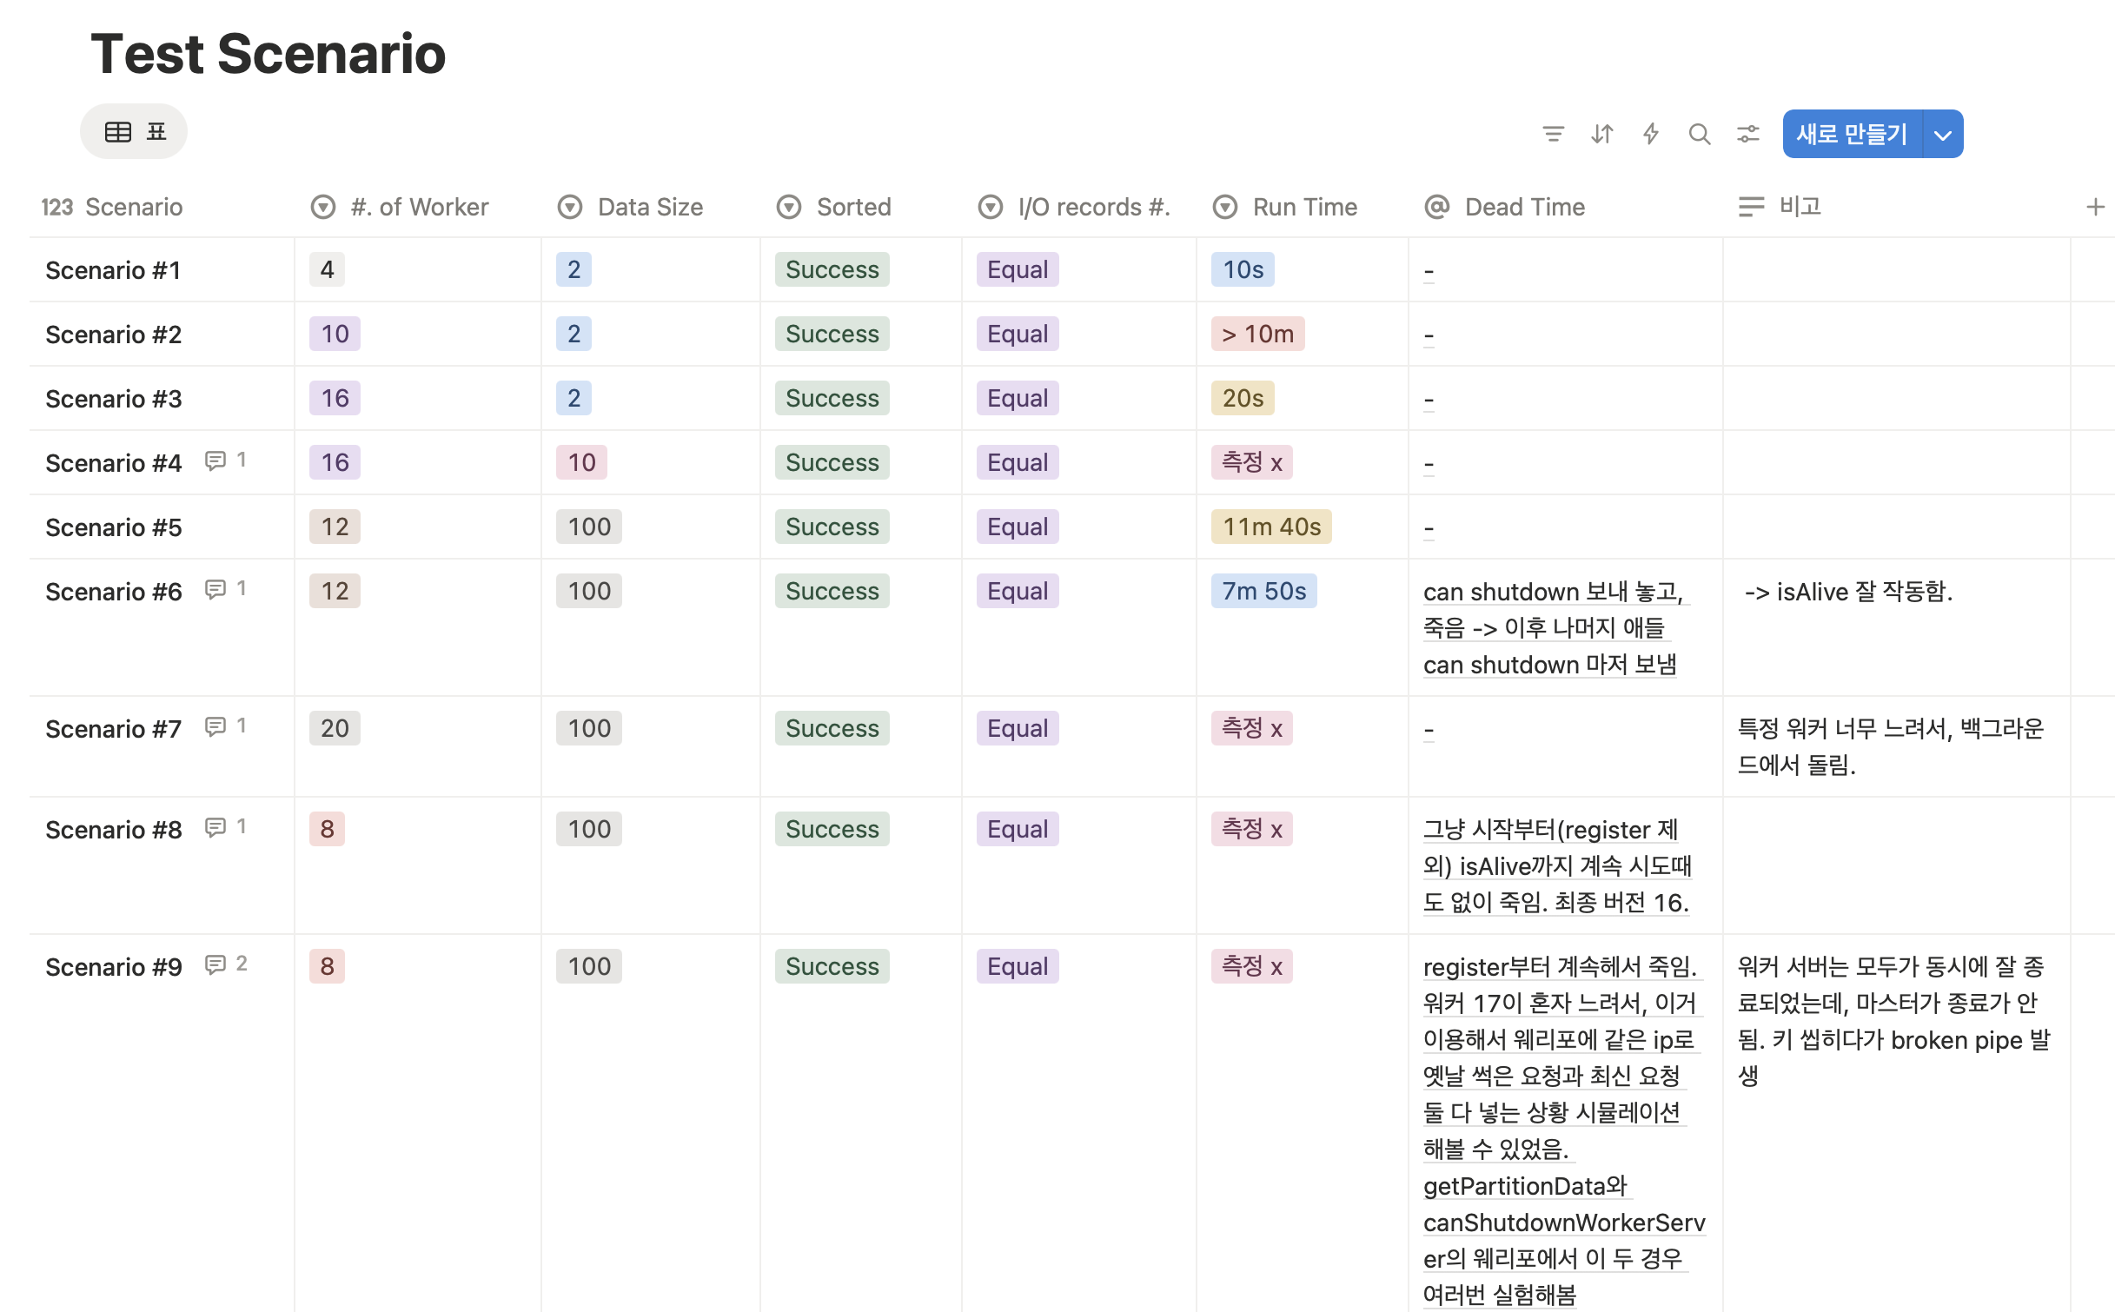
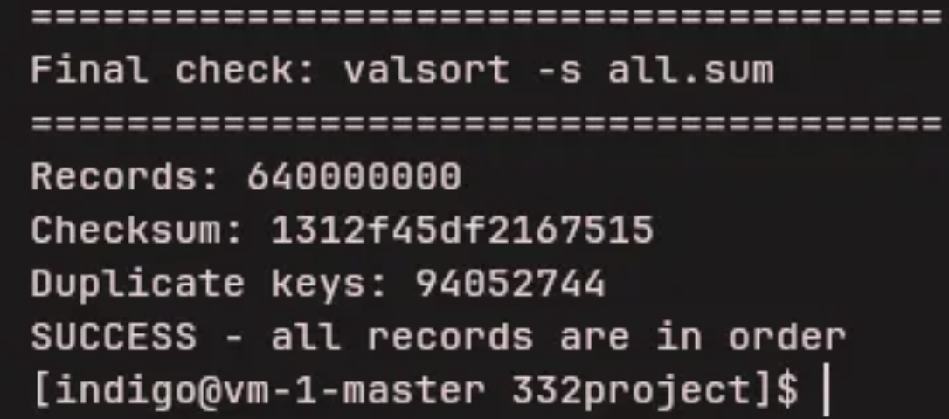
Results Report

Slide 3
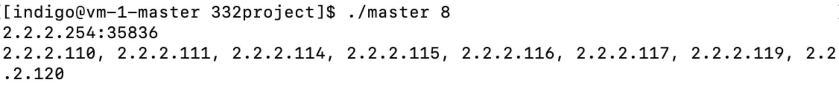
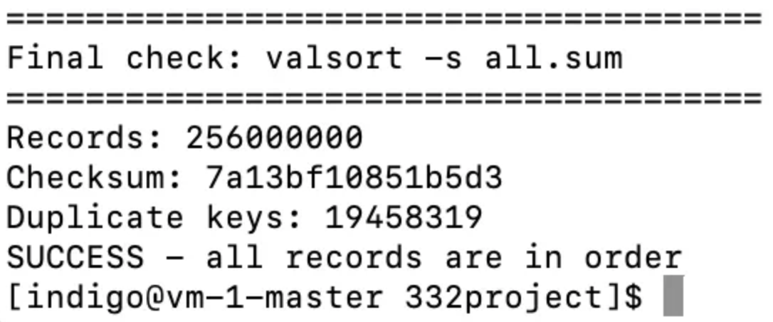
Results Report

Slide 4
Simulation : Program Execution Flow
Merge
Register
Sampling
Sort & Partitioning
Shuffling
Shutdown
Same with register!
Easy
Same with register!
But need to check whether workers are alive & finish jobs
M
Key Idea
gRPC
= Remote Procedure Call
= Call Function Remotely
→ Implement Function(register, getPartitionRange, ...)
Wait until all workers register to save ip, port
Use Promise!
Ip, Port
If sort & partitioning is not finished: wait for the partitioning to complete (Promise).
Else: send the data immediately.
Data (gRPC stream)
W1
Workers’ ip, port
W3
Waiting Request For Register (ListBuffer[Promise])
W1
W3
W1
ip
W2
W3
W2
ip
W2

Slide 5
Simulation : Program Execution Flow
Its behavior must be determined by the worker's current state.
Merge
Register
Sampling
Sort & Partitioning
Shuffling
Shutdown
The operation can proceed without considering the status of any other worker.
gRPC exception, during get Partition Data
Call register to get updated workers’ ip, port
Then, retry it.
gRPC exception
Let’s keep it simple!
Even if the process is killed midway, running it again from the beginning will produce the same result. Therefore, no additional metadata needs to be stored. It may be slower, but the overall design becomes much simpler.

Slide 6
Example : w/ kill worker in shuffling
Update workers’ info
M
Get workers’ info
Register
gRPC exception
W1
ip
W3
Data
W2

Slide 7
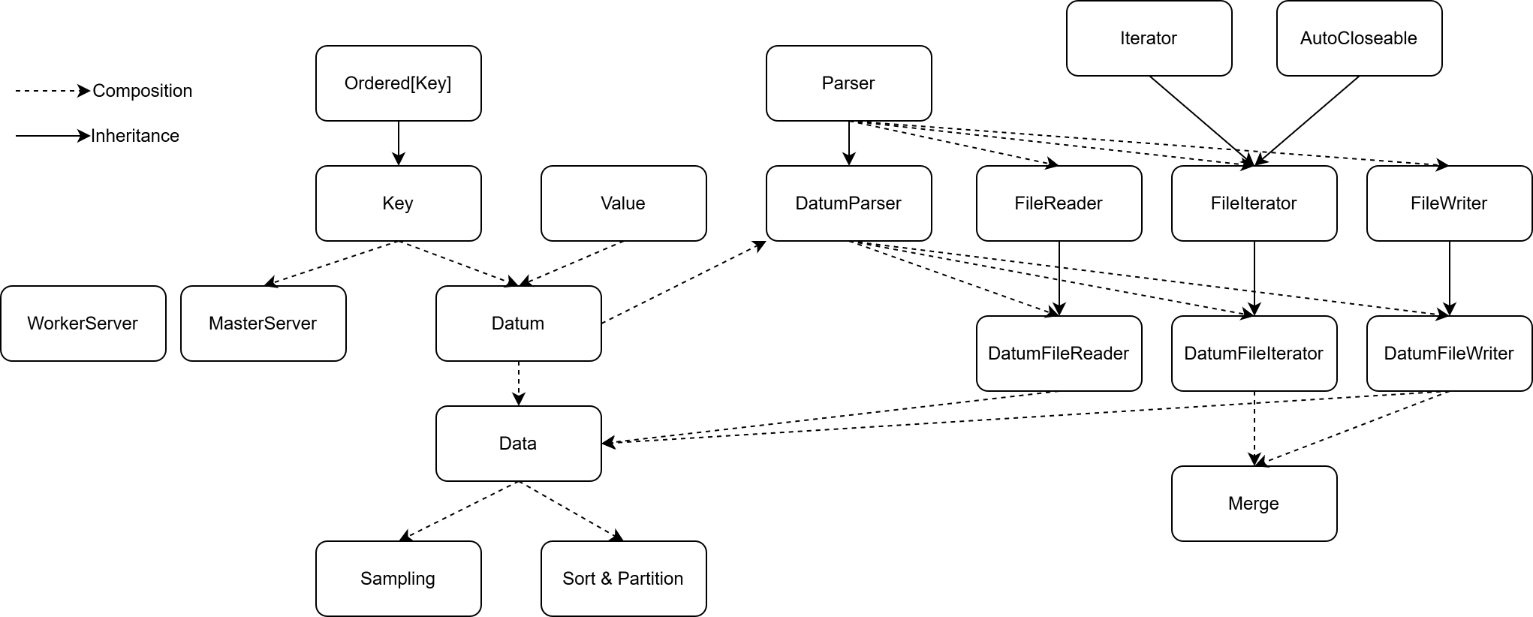
Architecture of Our System

Slide 8
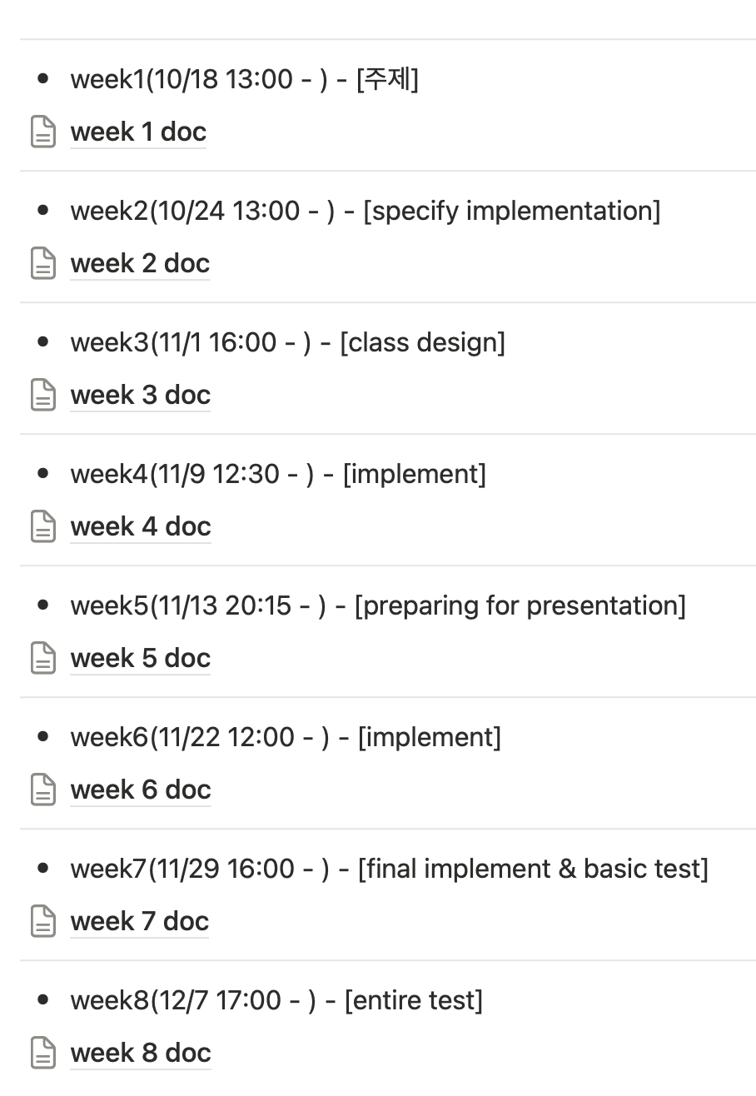
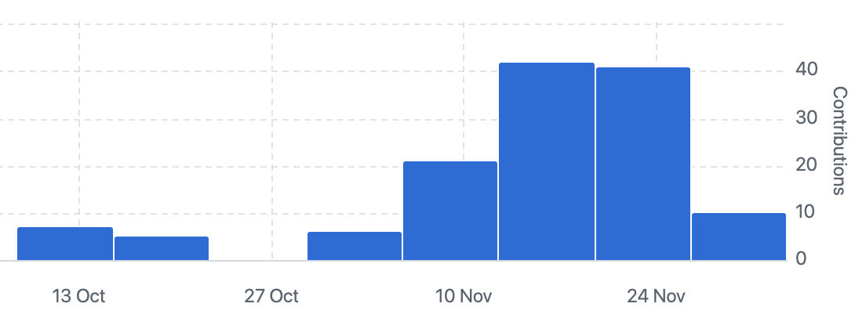
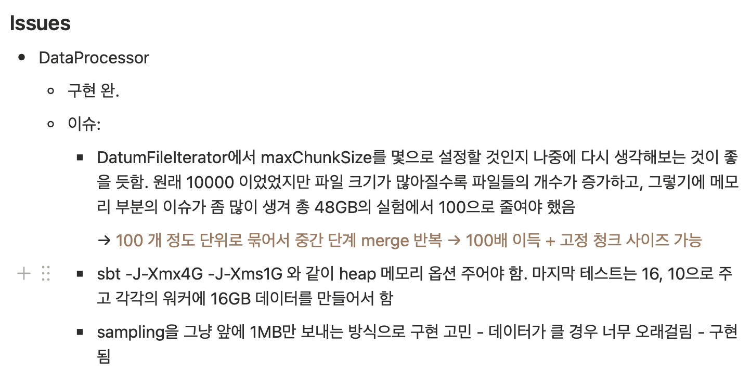
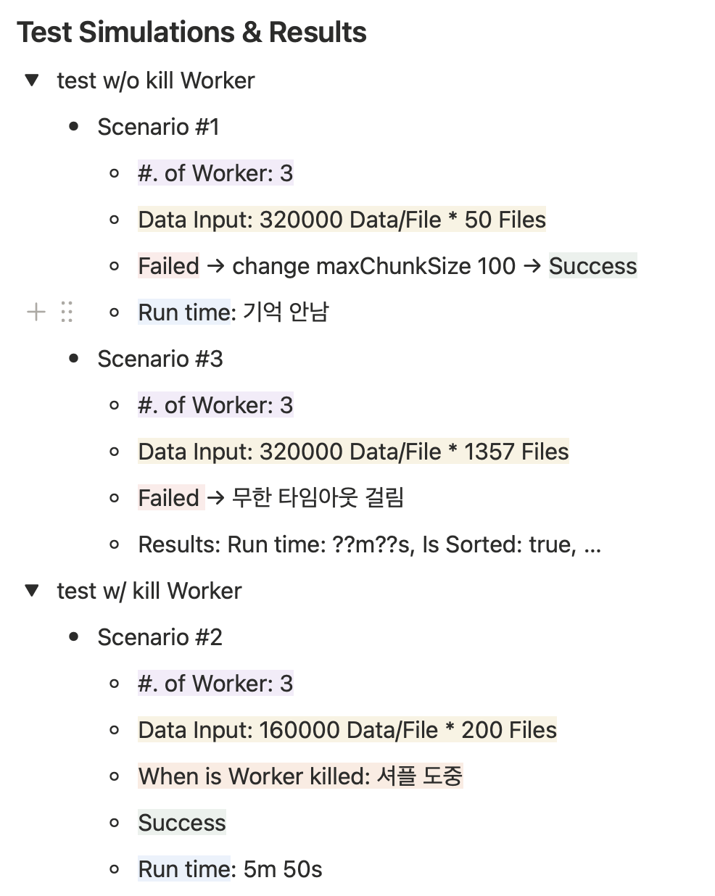
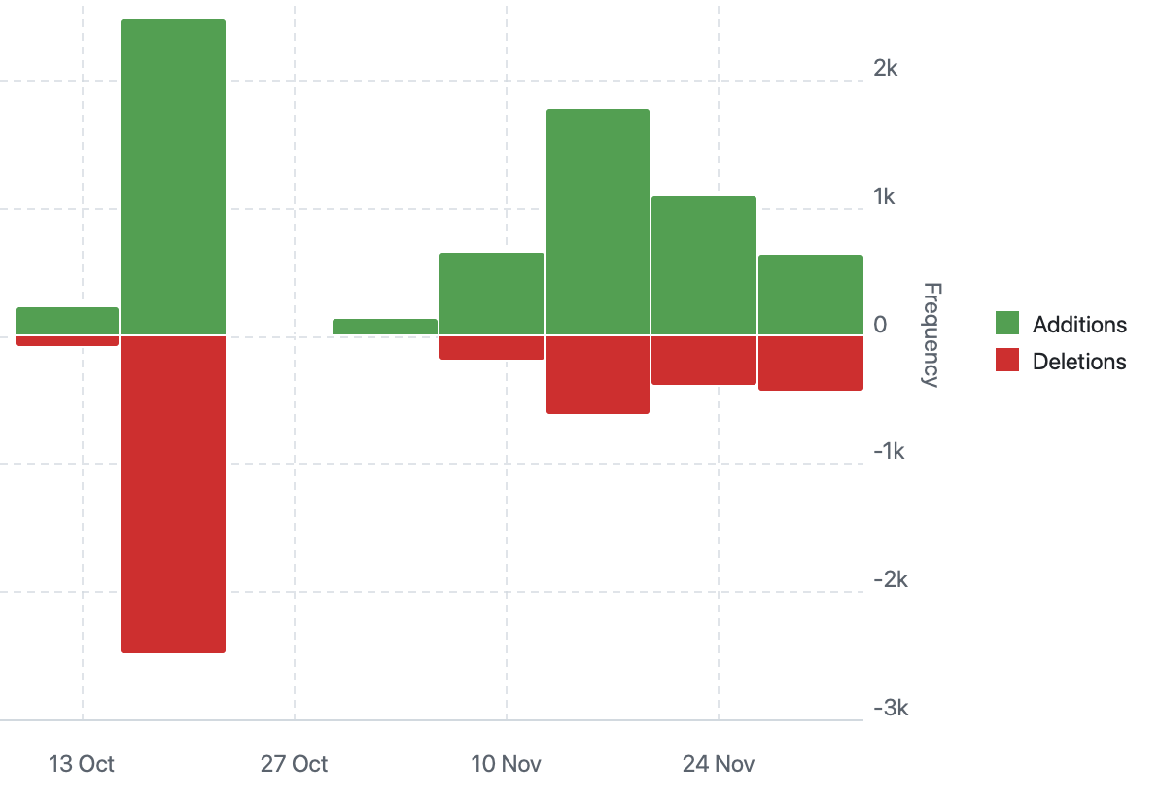
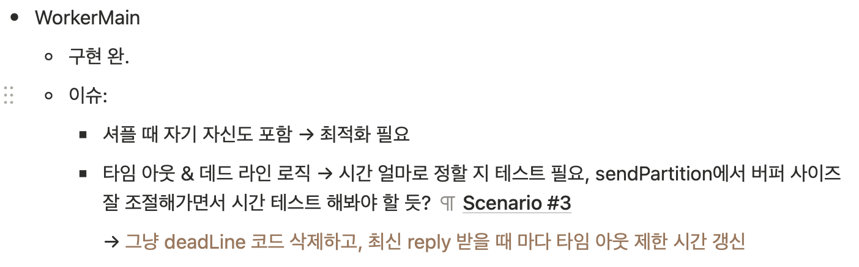
Overall Progress Summary/ Remain Issues
gRPC’s buffer size ≈ 4MB
server push speed > client pop speed, the buffer fills up and causes issues.
Notes:
If master write speed > worker read speed, the buffer fills up and causes issues. 말할 때 주어진 데이터 (3.2GB) 에서는 버퍼가 다 차기 전에 보내기 작업이 완료되어 문제 없음 말하기 + 이에 대한 해결 방식은 그냥 버퍼가 차 있으면 데이터를 버퍼에 넣지 않도록 수정하면 된다. 라고 하면 될 듯

Slide 9
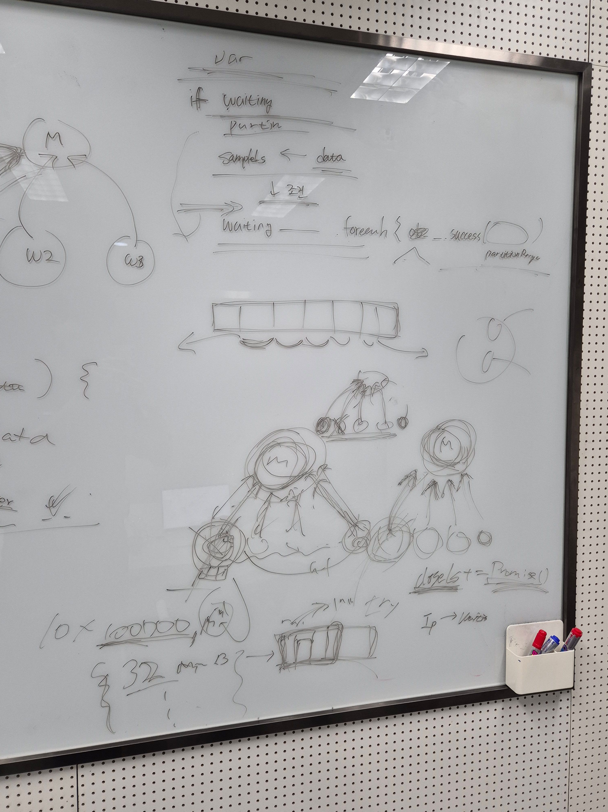
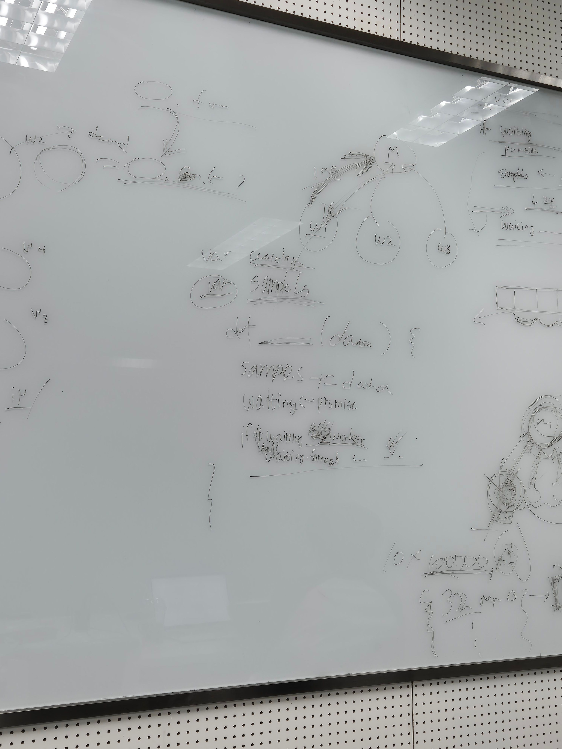
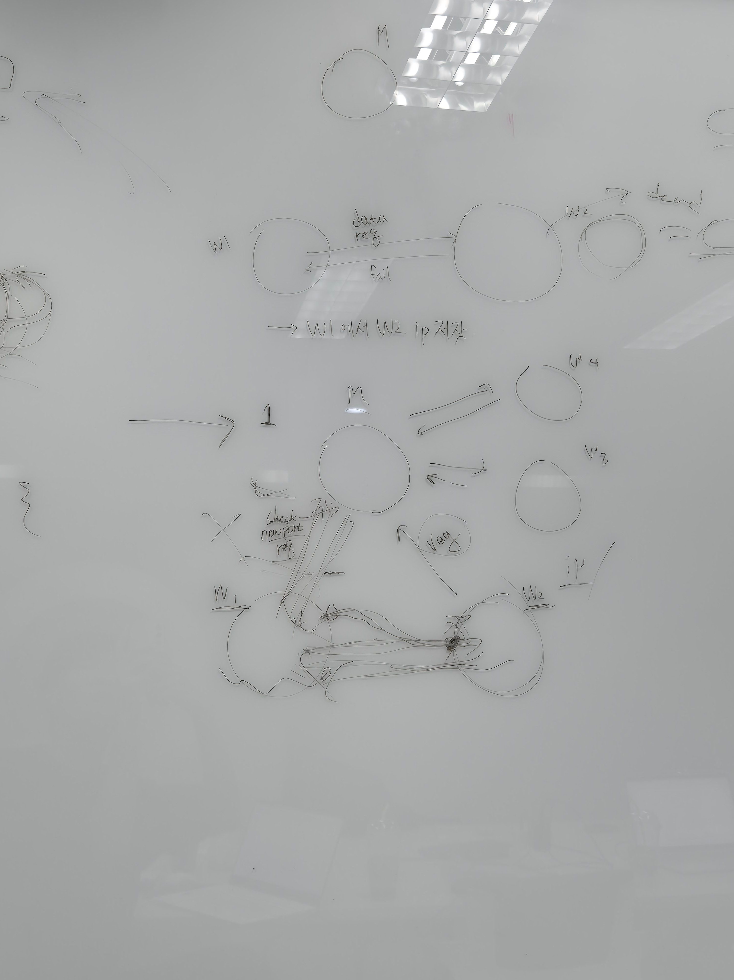
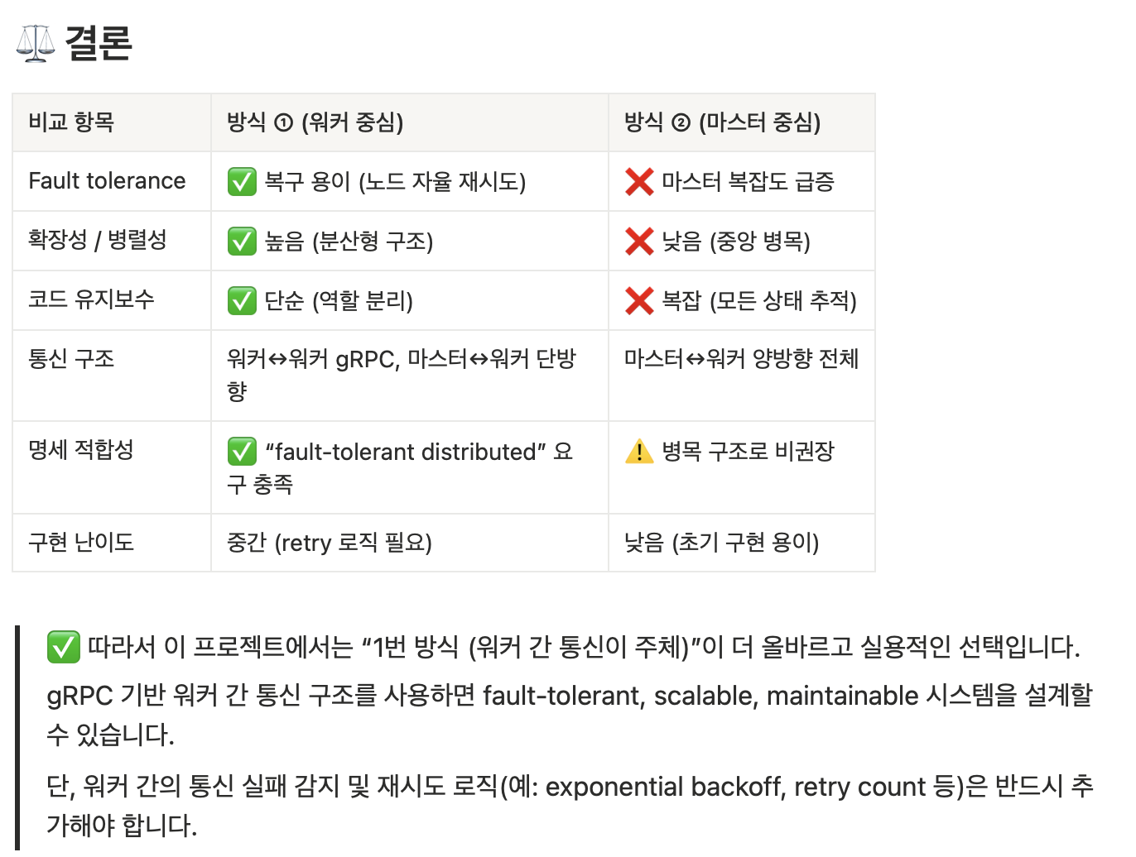
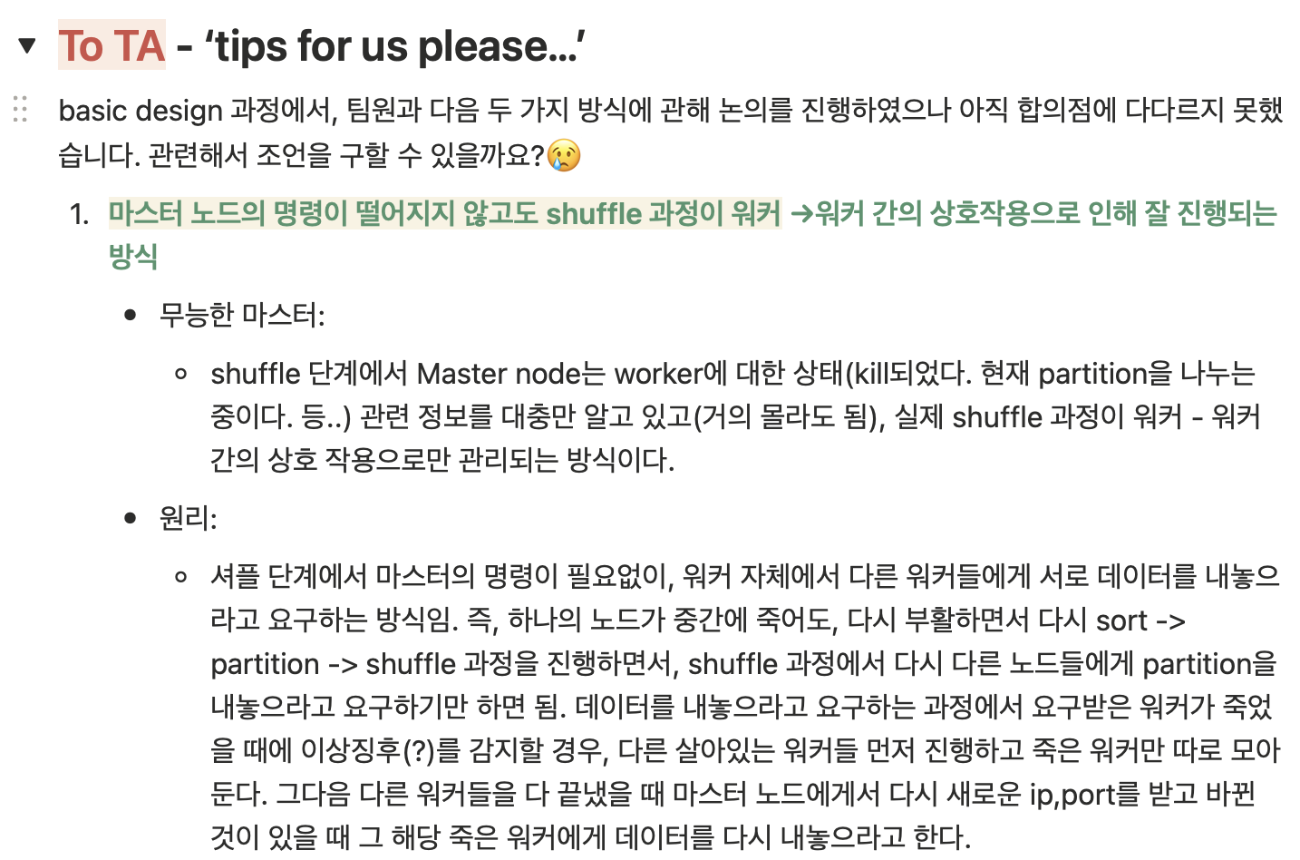
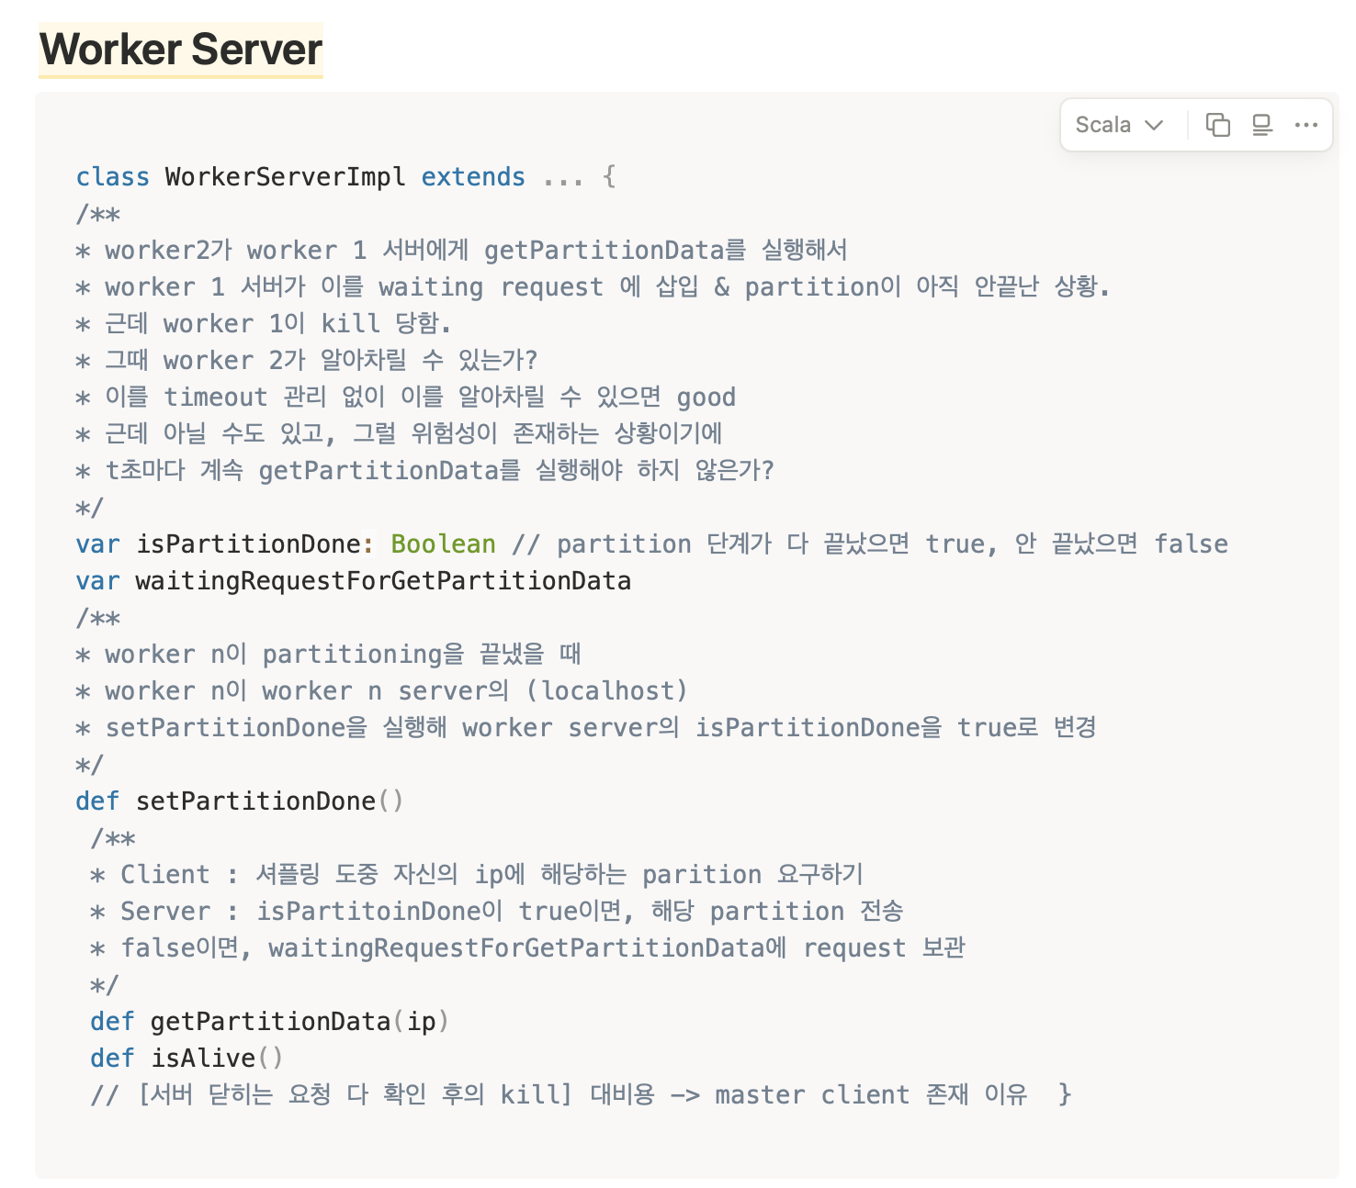
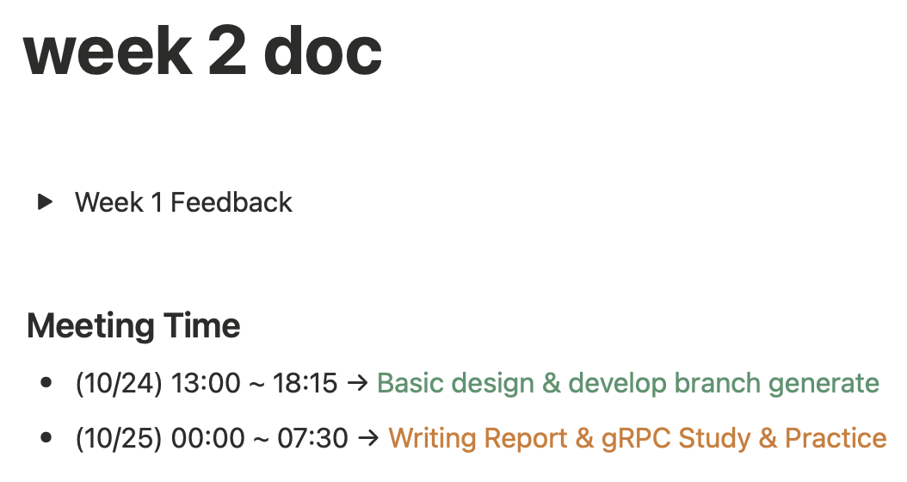
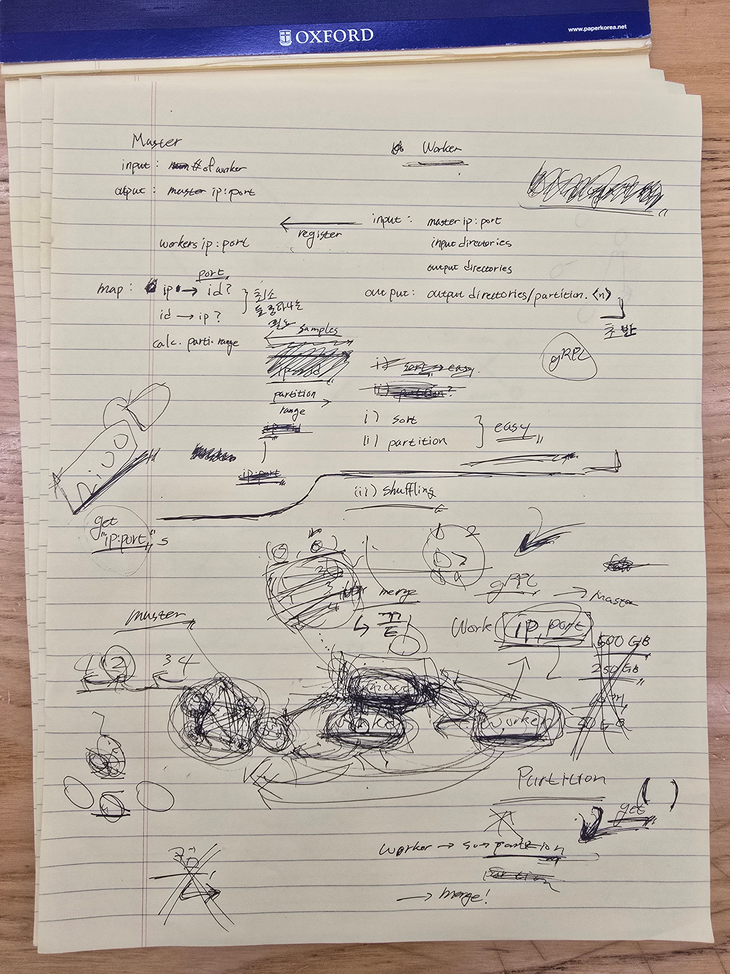
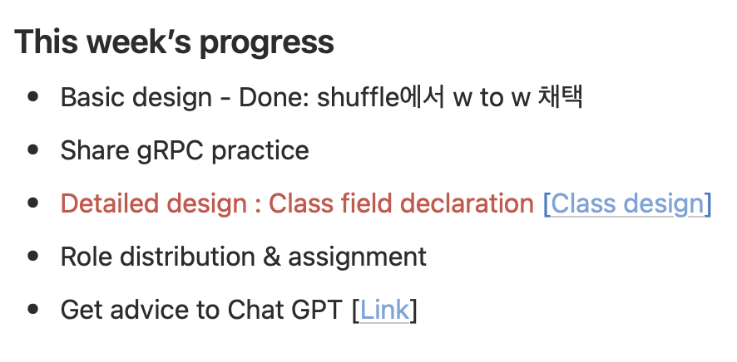
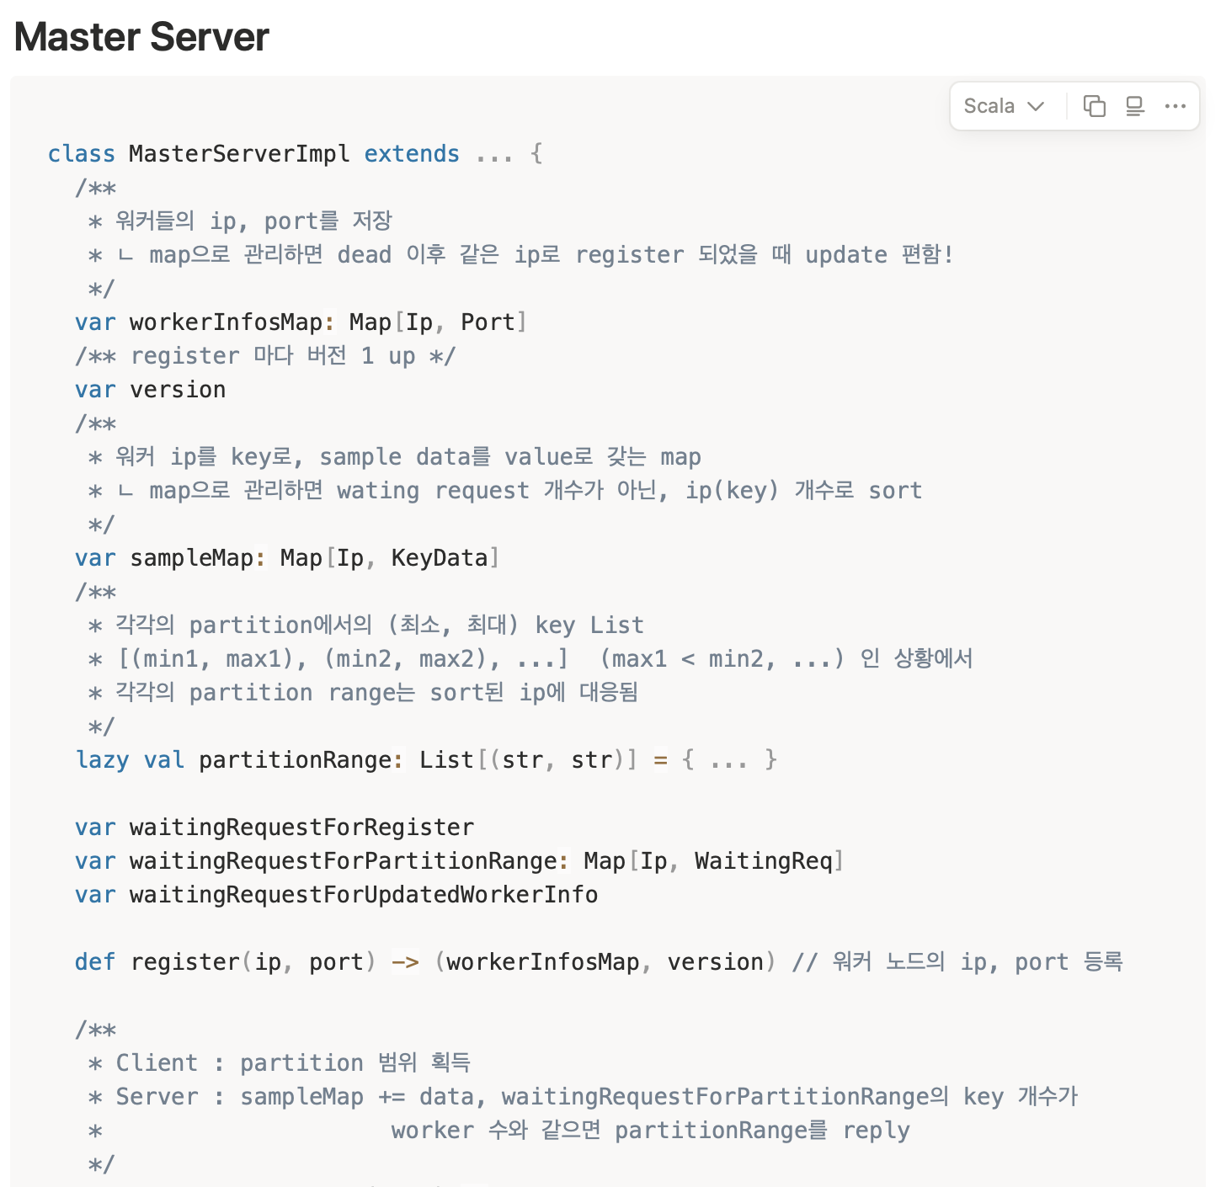
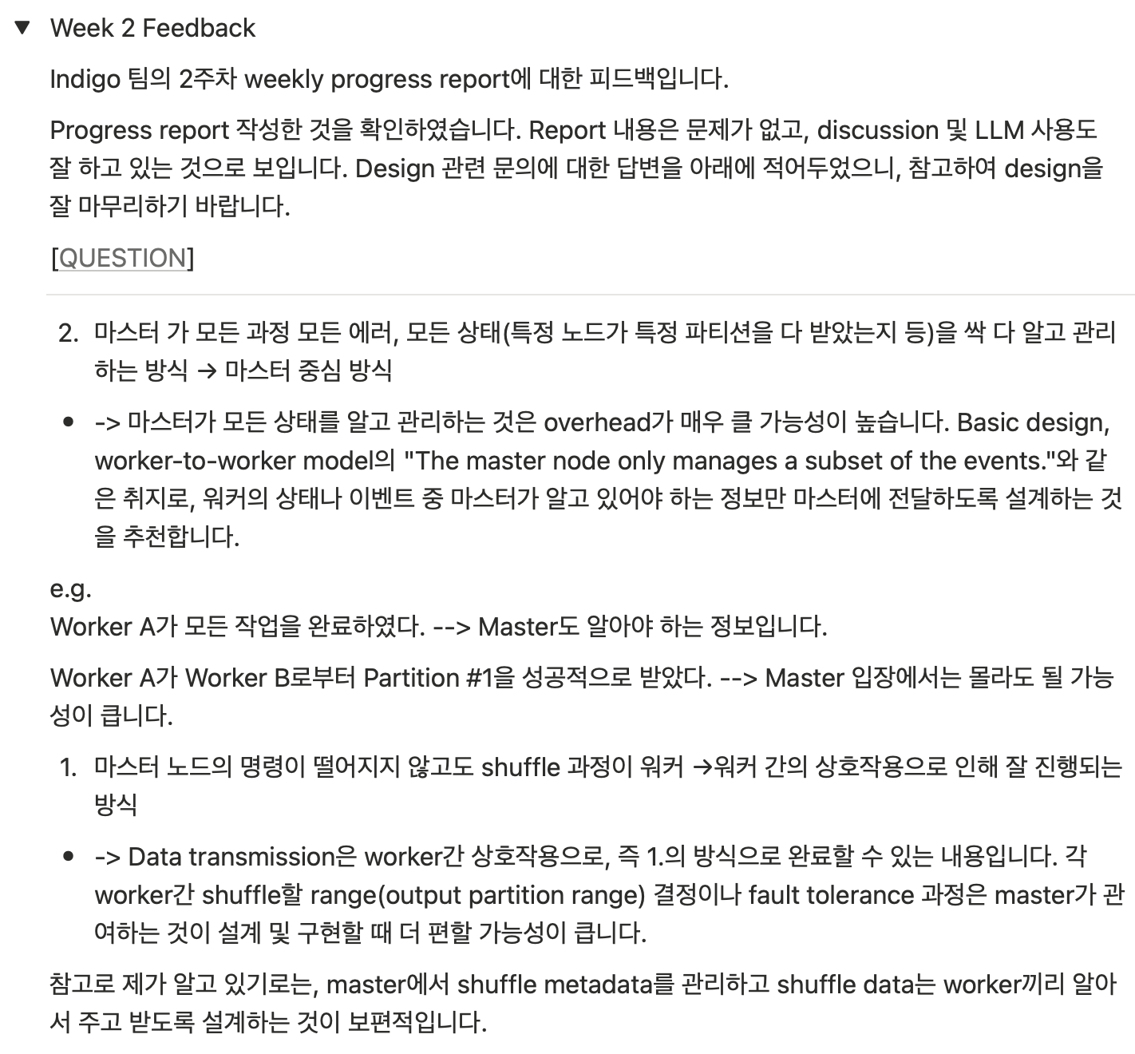
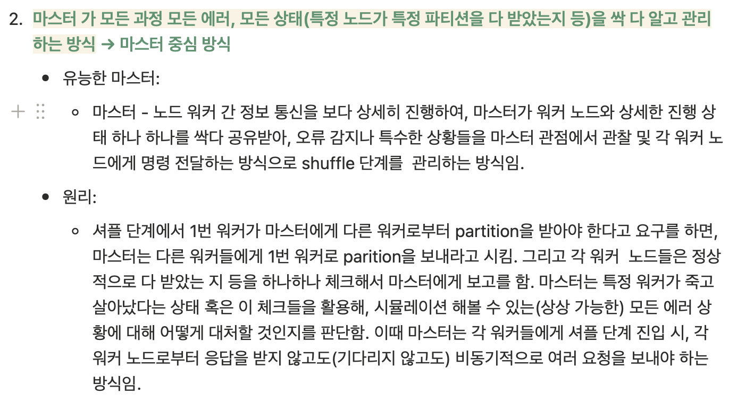
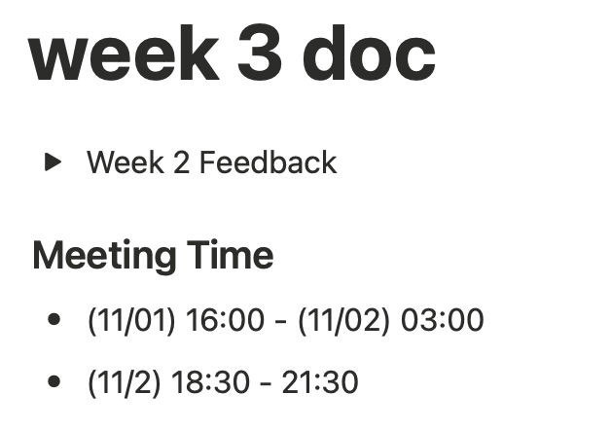
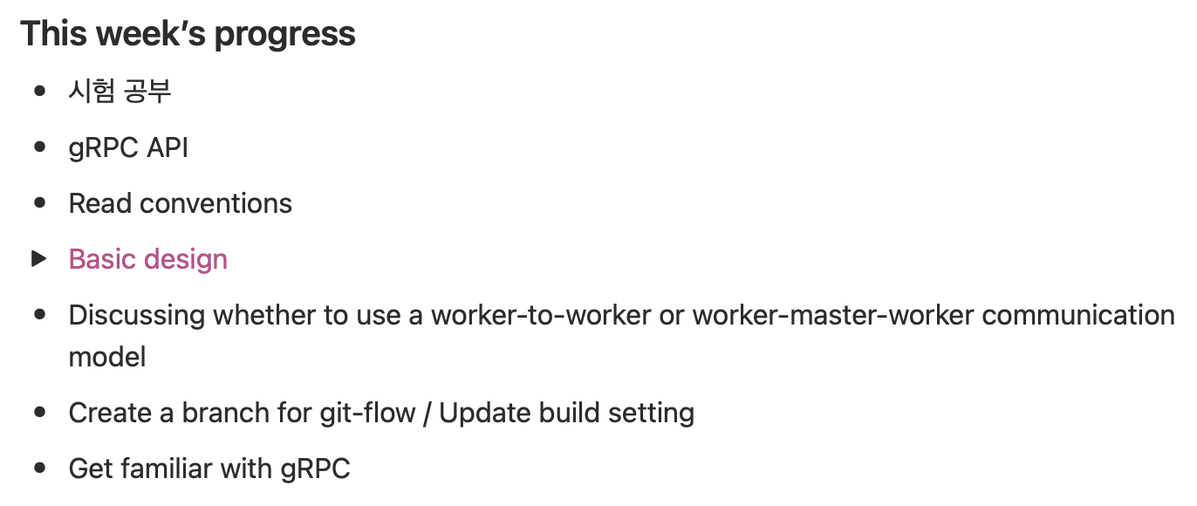
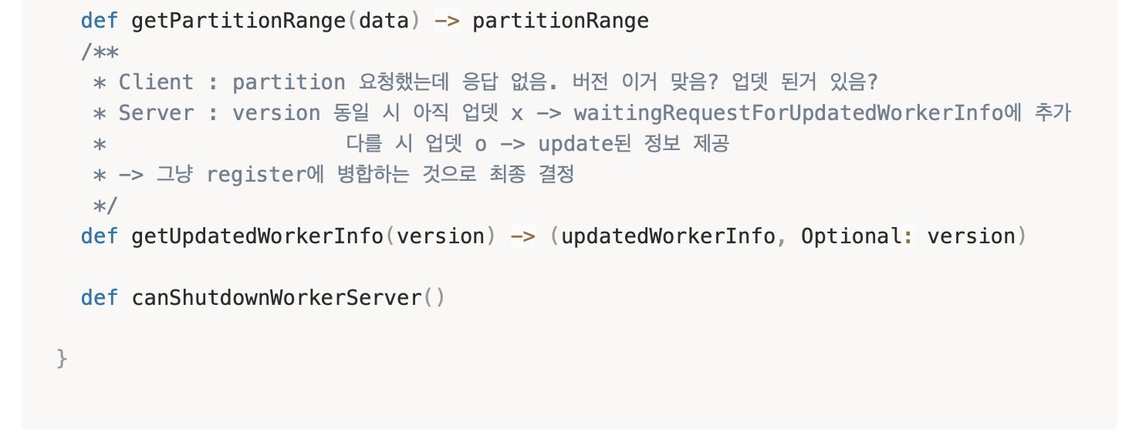
Why Our Project was Successful
12h 45m !!
14h !!

Slide 10
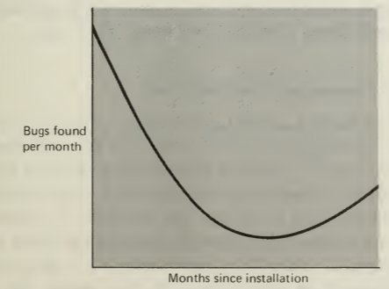
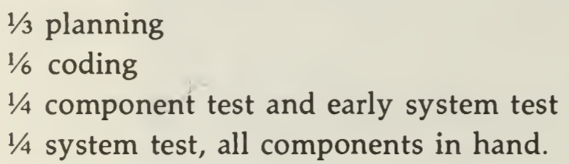
What We Learned…
Teams should communicate with one
another in as many ways as possible

Slide 11
Q&A

